Slide 1


Computer
Lecture 5
Dr. Nada Abdullah Rasheed
Assist prof. / Computer Science

Slide 2
Syllabus Content
Subject | Lec. No.
Hardware and Software - Introduction | 3
Hardware: | 3
Software: | 4
PC Components | 7
Input Devices: | 8

Slide 3
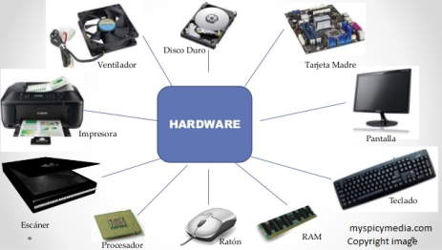
Hardware and Software
Introduction
A computer system is made up of a combination of hardware and software.
Hardware:
All of the electronic and mechanical equipment in a computer is called the hardware. Examples include:
• Motherboard
• Hard disk
• RAM
• Power supply
• Processor
• Case
• Monitor
• Keyboard
• Mouse

Slide 4
Software:
The term software is used to describe computer programs that perform a task or tasks on a computer system. Software can be grouped as follows:
System software: These are the programs that control the operation of the computer system. Operating Systems and utility programs are the most common. The Operating System starts the computer, provides a user interface, manages the computer memory, manages storage, manages security and provides networking and internet facilities to mention a few of its capabilities.

Slide 5
market including Microsoft Windows XP, Microsoft Windows Vista, Apple OS X, Unix and Linux. Windows is by far the most commonly used OS in the world, but Linux in particular, is making inroads into this dominance.
Utility programs perform maintenance tasks on the computer system. This includes file management program, uninstall programs, disk scanners and defragmenters, backup utilities, antivirus, etc. These can be included in the OS or purchased separately.

Slide 6
Device drivers are programs that control particular hardware devices. They are supplied with new hardware and must be run so the hardware can communicate with the OS. They are supplied with printers, graphics cards, scanners etc.
Application Software: This software is used to do non-system based tasks. Categories include business software, engineering software, medical software, games etc.
Sometimes, application software packages are grouped together to form productivity suites. Examples include Microsoft Office and Open Office. These combine word processing, spreadsheet, database, and presentation software. These packages have a common interface making them easier to learn. The Adobe Creative suite combines Adobe Photoshop, Adobe Illustrator, Adobe In Design etc. as an all-in- one graphics and web design suite. As well as common interfaces, these suites offer great compatibility between the applications.

Slide 7
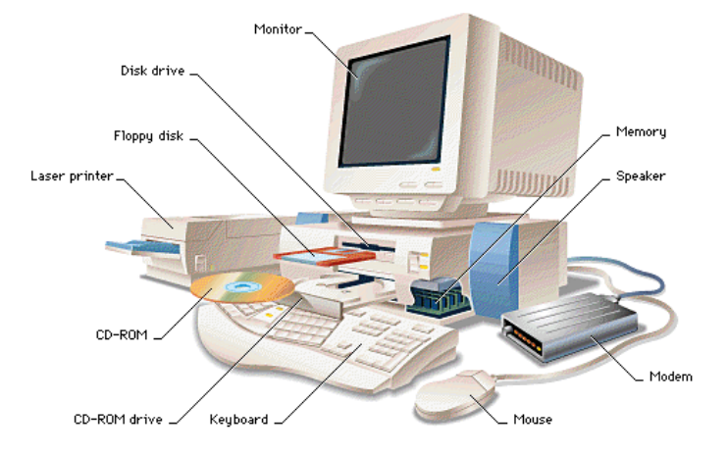
PC Components:
A computer system is a collection of electronic and mechanical devices operating as a unit. These devices can be sorted according to the role they play in the computer system. The main device categories are:
Input devices | These devices are used to get data into the computer system.
Processing devices | These manipulate the data using a set of instructions called a program.
Output devices | These are used to get data out of a computer system.
Storage devices | It can store the data for use at a later stage.
Communications Devices | These can send the data to another computer system.

Slide 8
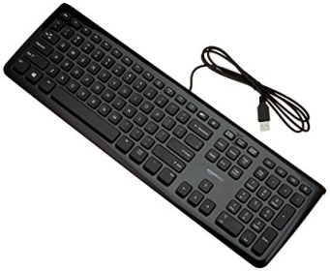
Input Devices:
This unit contains devices with the help of which we enter data into the computer. This unit creates a link between the user and the computer. The input devices translate the information into a form understandable by the computer. Following are some of the important input devices which are used in a computer: Keyboard, Mouse, Joystick, Light pen, Track Ball, Scanner, Graphic Tablet, Microphone, and Bar Code Reader.
Keyboard
The keyboard is the most common and very popular input device which helps to input data to the computer. The layout of the keyboard is like that of traditional typewriter, although there are some additional keys provided for performing additional functions.

Slide 9
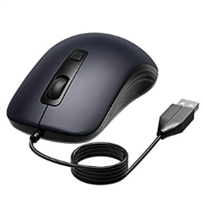
Mouse
The mouse is the most popular pointing device. It is a very famous cursor-control device having a small palm size box with a round- ball at its base, which senses the movement of the mouse and sends corresponding signals to the CPU when the mouse buttons are pressed. Generally, it has two buttons called the left and the right button and a wheel is present between the buttons. A mouse can be used to control the position of the cursor on the screen, but it cannot be used to enter text into the computer.
Advantages: Easy to use, Not very expensive, Moves the cursor faster than the arrow keys of the keyboard

Slide 10
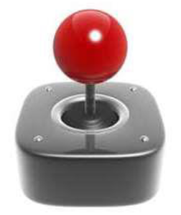
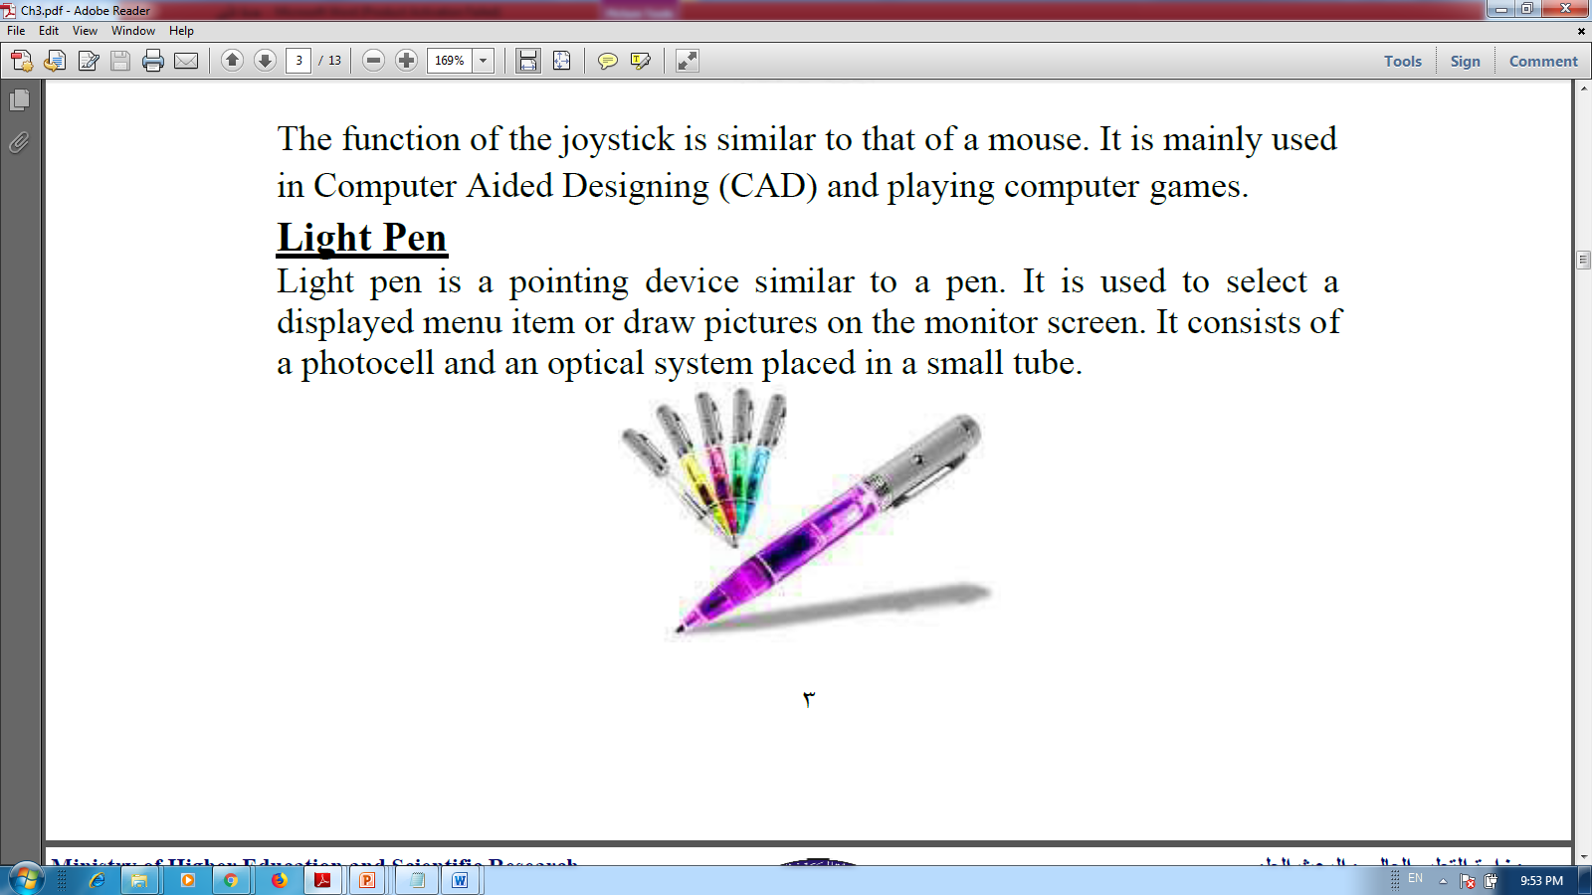
Joystick
Joystick is also a pointing device, which is used to move the cursor position on a monitor screen. It is a stick having a spherical ball at its both lower and upper ends. The lower spherical ball moves in a socket. The joystick can be moved in all four directions. The function of the joystick is similar to that of a mouse. It is mainly used in Computer Aided Design (CAD) and playing computer games.
Light Pen
Light pen is a pointing device similar to a pen. It is used to select a displayed menu item or draw pictures on the monitor screen. It consists of a photocell and an optical system placed in a small tube.
When the tip of a light pen is moved over the monitor screen and the pen button is pressed, its photocell sensing element detects the screen location and sends the corresponding signal to the CPU.

